Slide 1




WEEKLY AI UPDATE
Everyone is taking AI Seriously
Are you?
A fast AI translation is useless if it’s confidently wrong. Safety > Speed.
01/ 06
Notes:
1

Slide 2
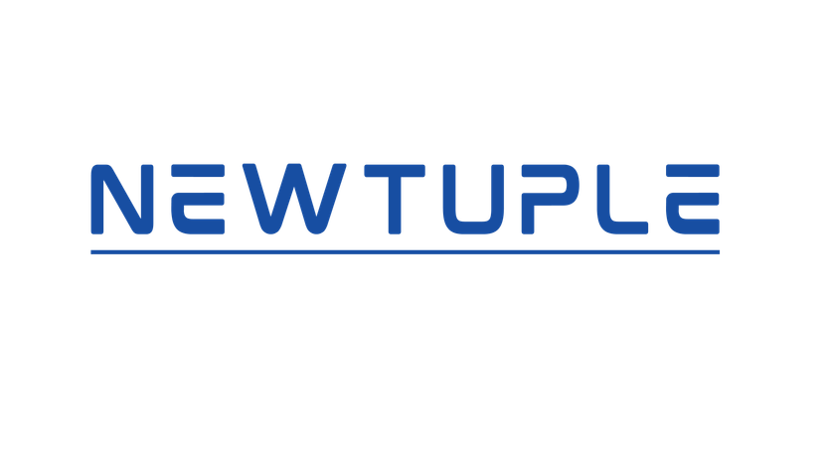





WHAT IT IS
Mythos is now inside 150 organisations across 15 countries.
Every one of them met security requirements before getting access. A successful attack on most of these codebases could affect over 100 million people .
Power grids
Water systems
Healthcare
Comms
Hardware
02/ 06
Notes:
2

Slide 3
ELSEWHERE THIS WEEK
Same week. Different company. Different trigger.
OpenAI published a 22-page governance document .
Three regulations in 48 hours forced it.
01
California
Transparency in Frontier AI Act
02
European Union
AI Act · Code of Practice for General Purpose AI
03
Illinois
Independent AI Audit Mandate
03/ 06
Notes:
3

Slide 4
TWO APPROACHES
One designed it in. One had to write it down.
ANTHROPIC · GLASSWING
OPENAI · FGF
Designed in
Written down
Governance built into deployment
Governance published after regulation
Access requires meeting security criteria
Document required by law
150 orgs · 15 countries · vetted
Public disclosure · auditable
04 / 06
Notes:
4

Slide 5
THE GAP
Your vendor now has a formal governance document. Mythos is running inside critical infrastructure with defined controls.
Most enterprise AI deployments have neither.
What your vendor documents
done
What Glasswing partners built
done
What your deployment has
?
05/ 06
Notes:
5

Slide 6
Your AI is already running.
What governs it?
This is the work we do with enterprise teams.
Are you ready for this?
newtuple.com
06/ 06
Notes:
6

